Slide 1
1
Ice Sheet
Mothership
2
Mothership
Deploy
Mothership
3
Collect Data
Return

Slide 2
Ice Sheet
Mothership
Deploy
Return

Slide 3
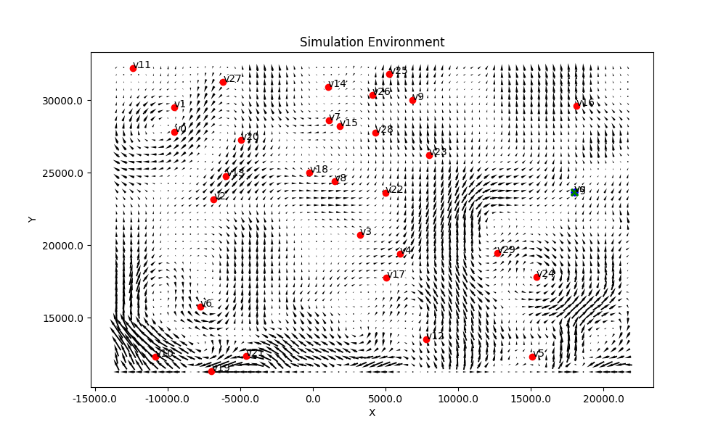
Mothership
Hybrid Decentralized Mission Planning
Coordinated Multi-Robot Tours

Slide 4
Stochastic Multi-Robot Orienteering Problem
Mothership
Hybrid Decentralized Mission Planning
Coordinated multi-robot tours

Slide 5
Mothership
Hybrid Decentralized Mission Planning
Coordinated multi-robot tours

Slide 6
Mothership

Slide 7
Mothership

Slide 8
Mothership

Slide 9
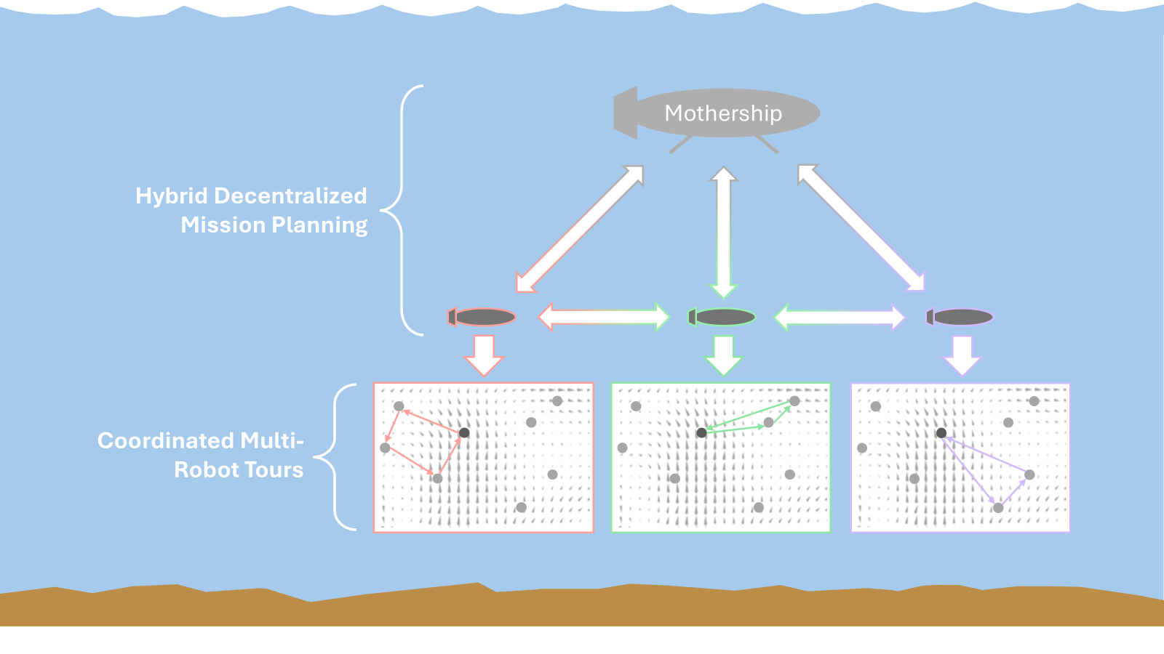
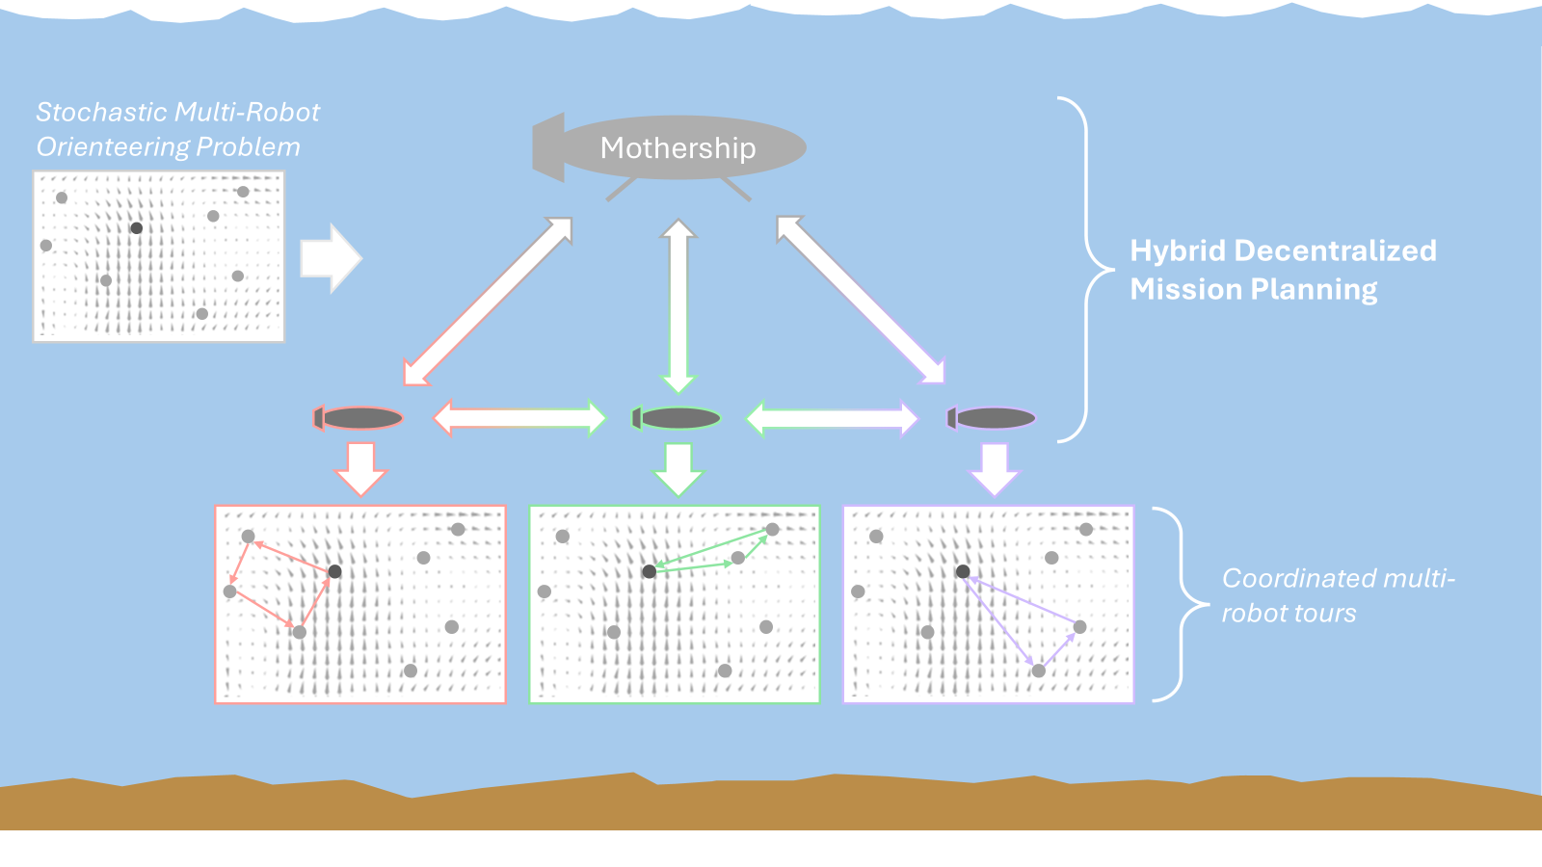
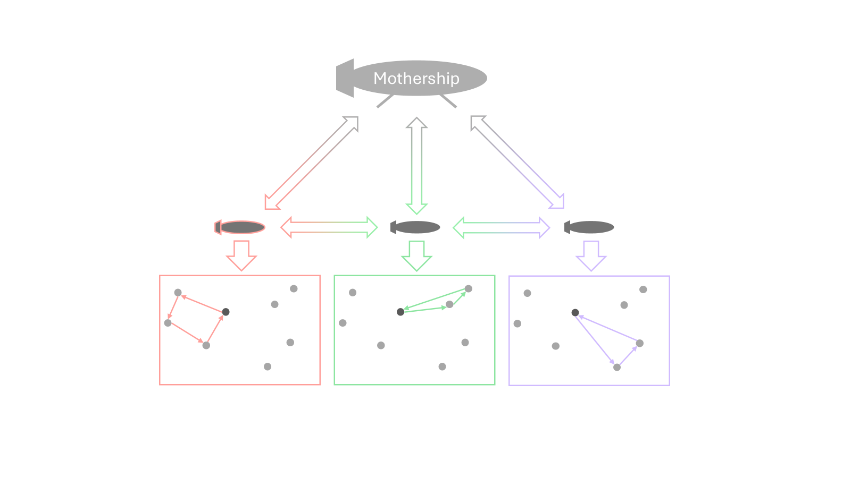
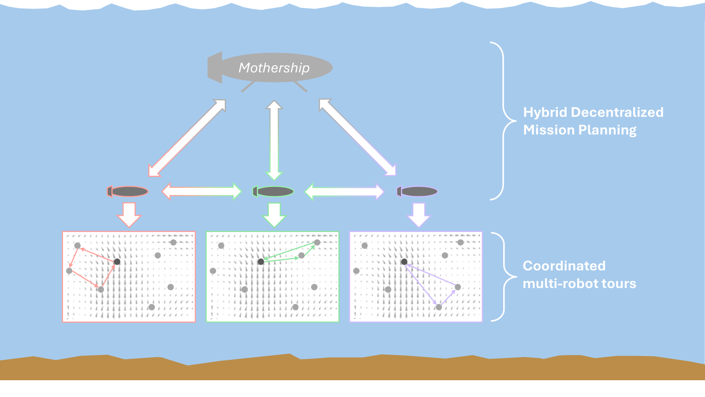
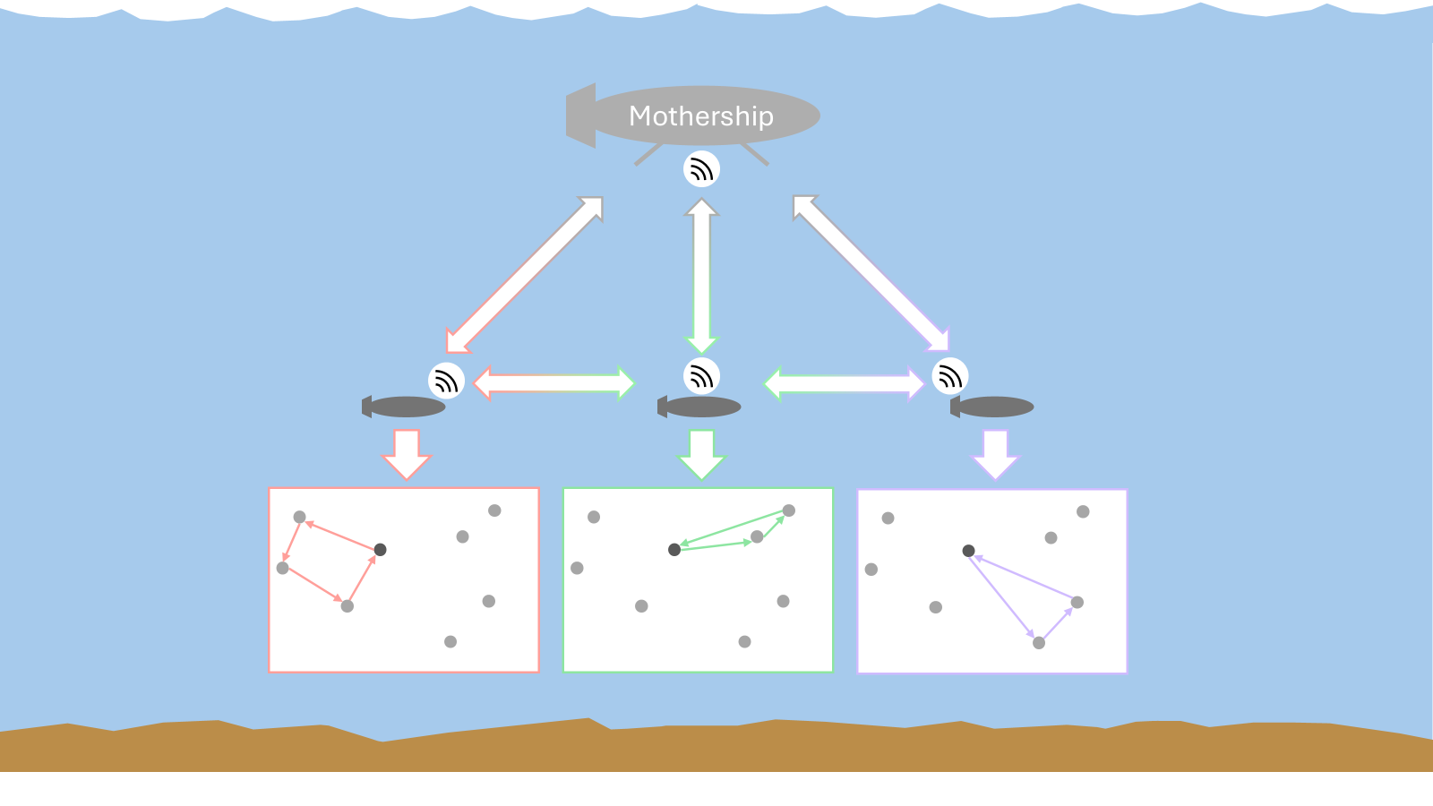
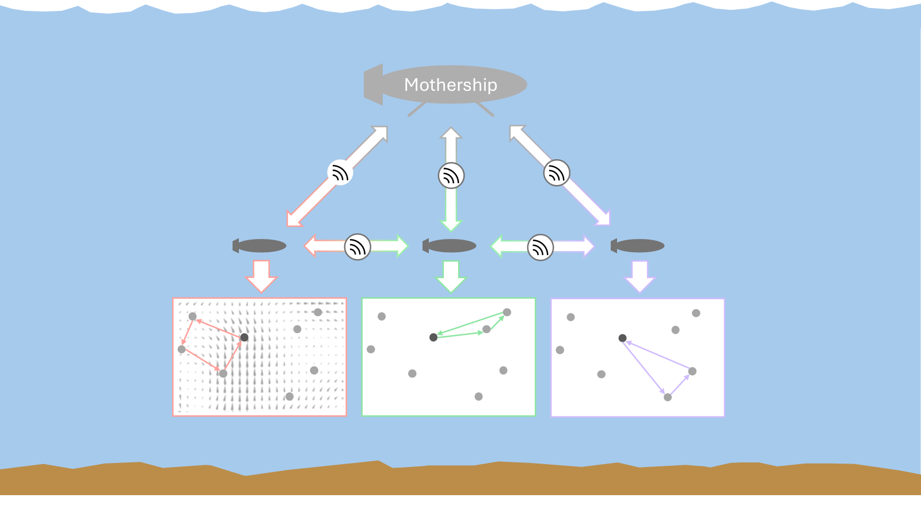
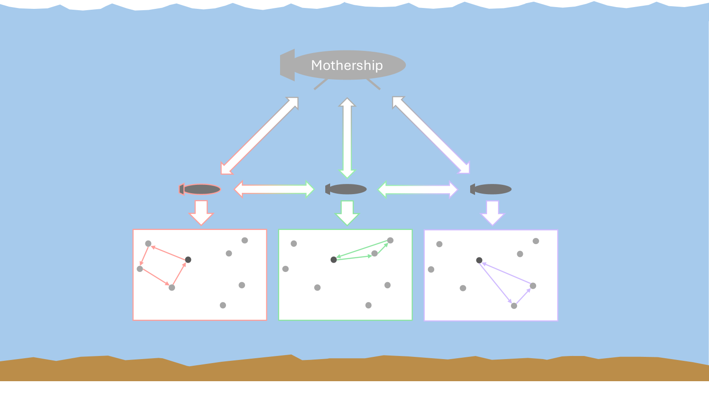

Slide 10
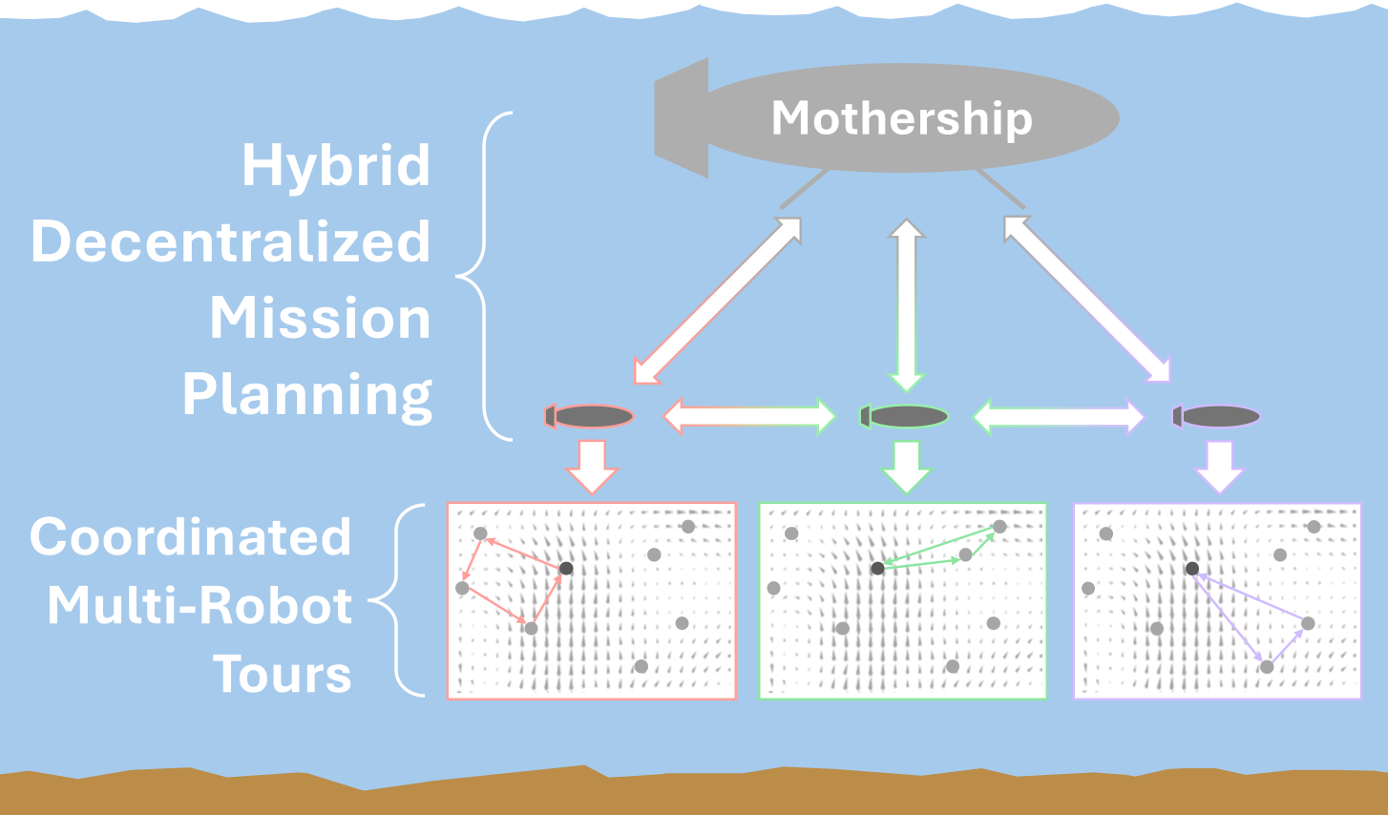

Slide 11
Ice Sheet

Slide 12
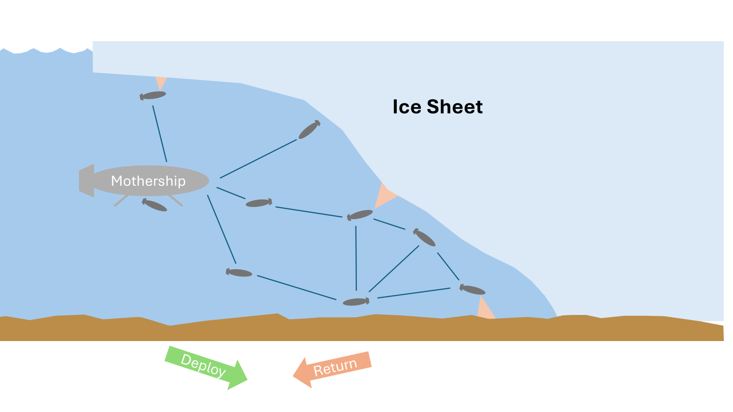
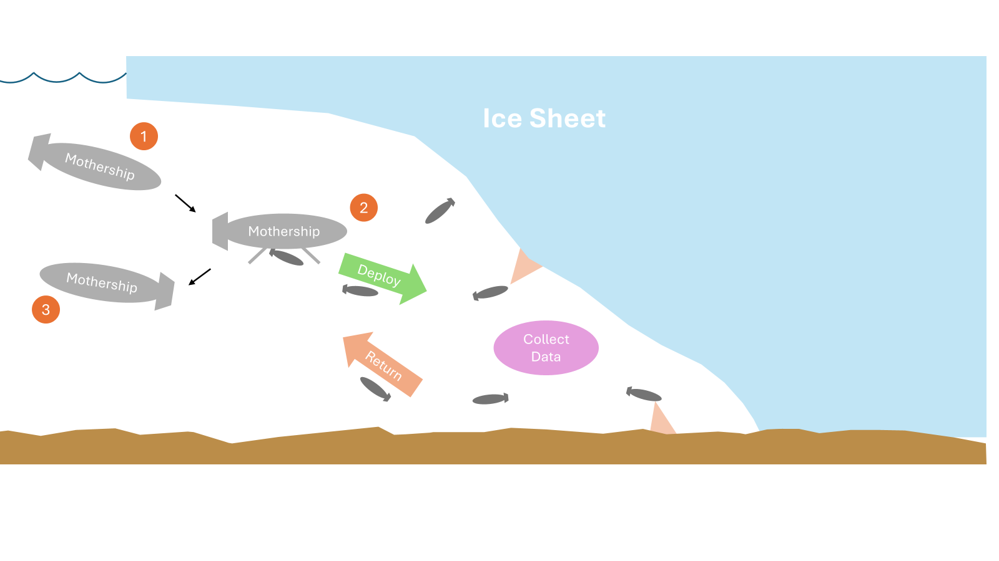
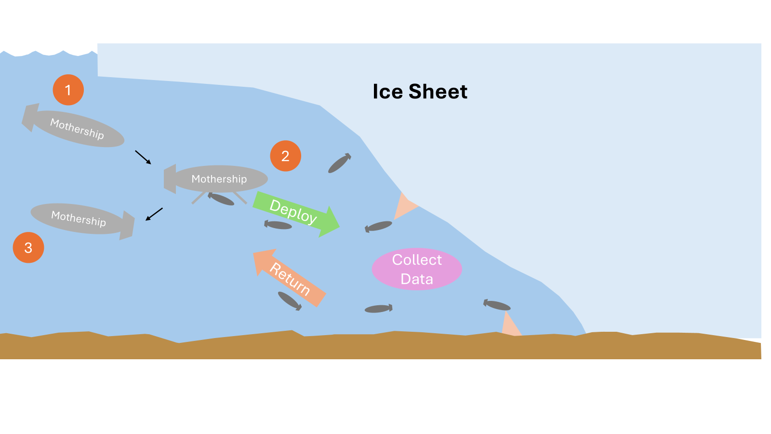
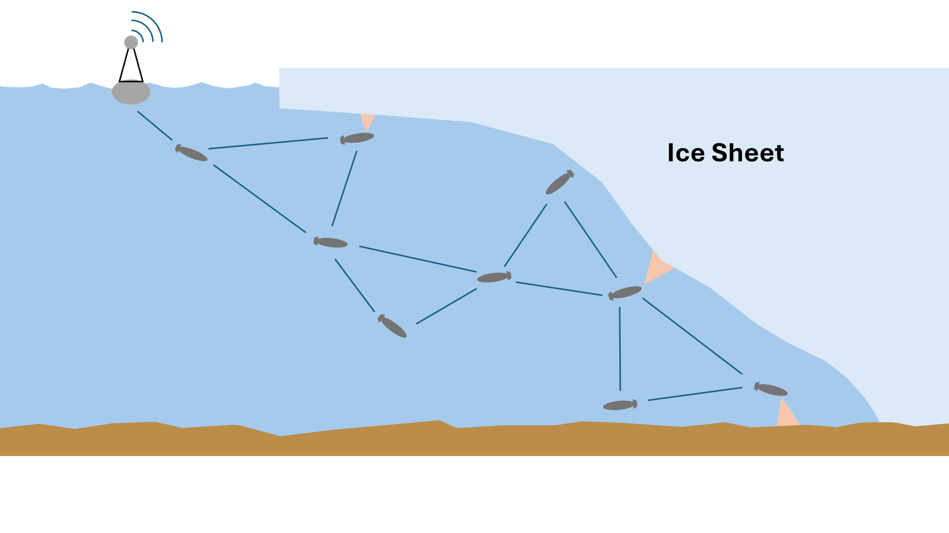

Slide 13
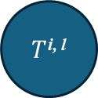
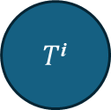
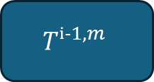
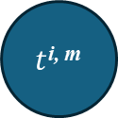
$$Tⁱ^{−1, m}$$
$T$^{i}
$T$^{i, l}
$t$^{i, m}
Passenger i
ti,m
Ti
SOP Solver
(MCTS)
Task Data
Neighboring Passengers
Task Data
Mothership
Schedule Selection Algorithm
STOP & SOP Solver
(Sim-BRVNS)
Passenger i Schedule Dist

Slide 14
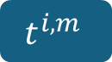
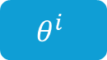
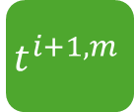


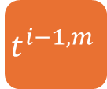
$$t^{i−1, m}$$
$$t^{i, m}$$
$$t^{i+1, m}$$
Passenger i
$$t^{i, m}$$
SOP Solver
(MCTS)
$$T^{i}$$
Mothership
Task Data
Task Data
Neighboring Passengers
STOP & SOP Solver
(Sim-BRVNS)
UpdateScheduleDists
$$θ^{i}$$

Slide 15
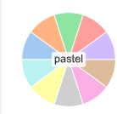

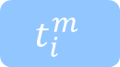
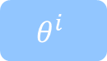
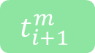

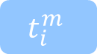
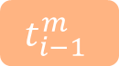
$$t_{i−1}^{m}$$
$$t_{i}^{m}$$
$$t_{i+1}^{m}$$
Passenger i
$$t_{i}^{m}$$
SOP Solver
(MCTS)
$$T_{i}$$
Mothership
Task Data
Task Data
Neighboring Passengers
STOP & SOP Solver
(Sim-BRVNS)
UpdateScheduleDists
$$θ^{i}$$

Slide 16
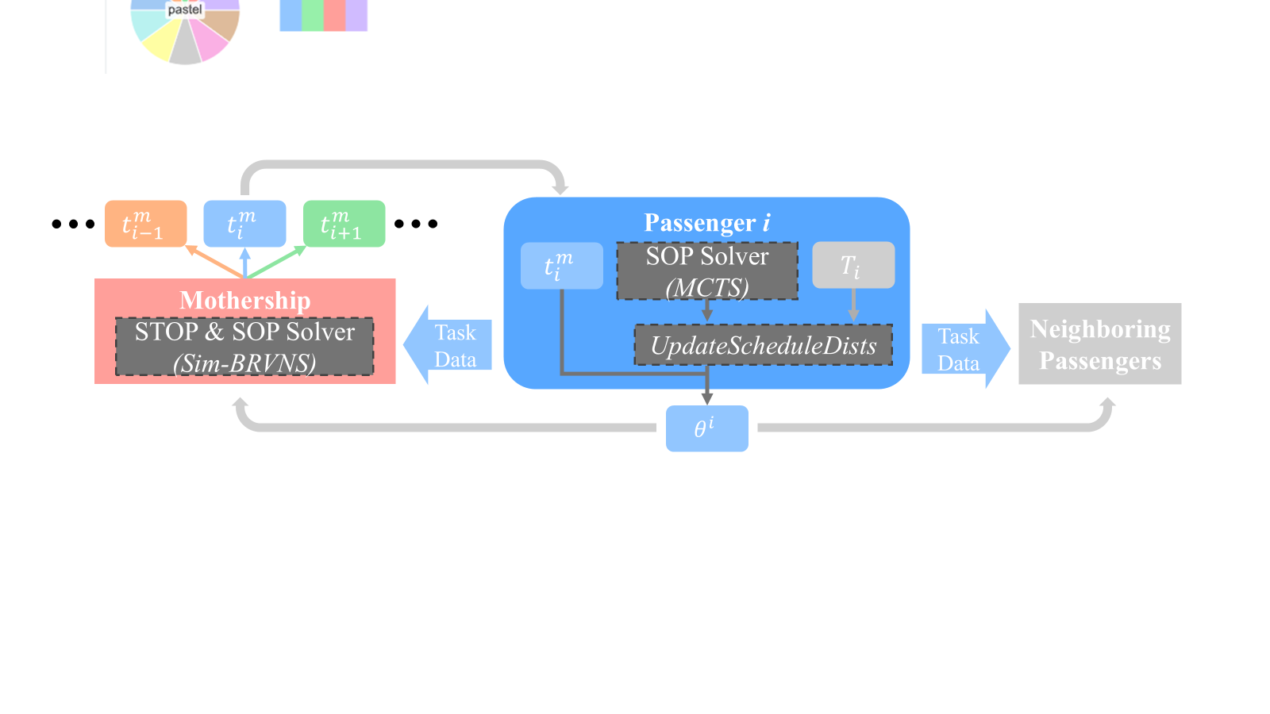
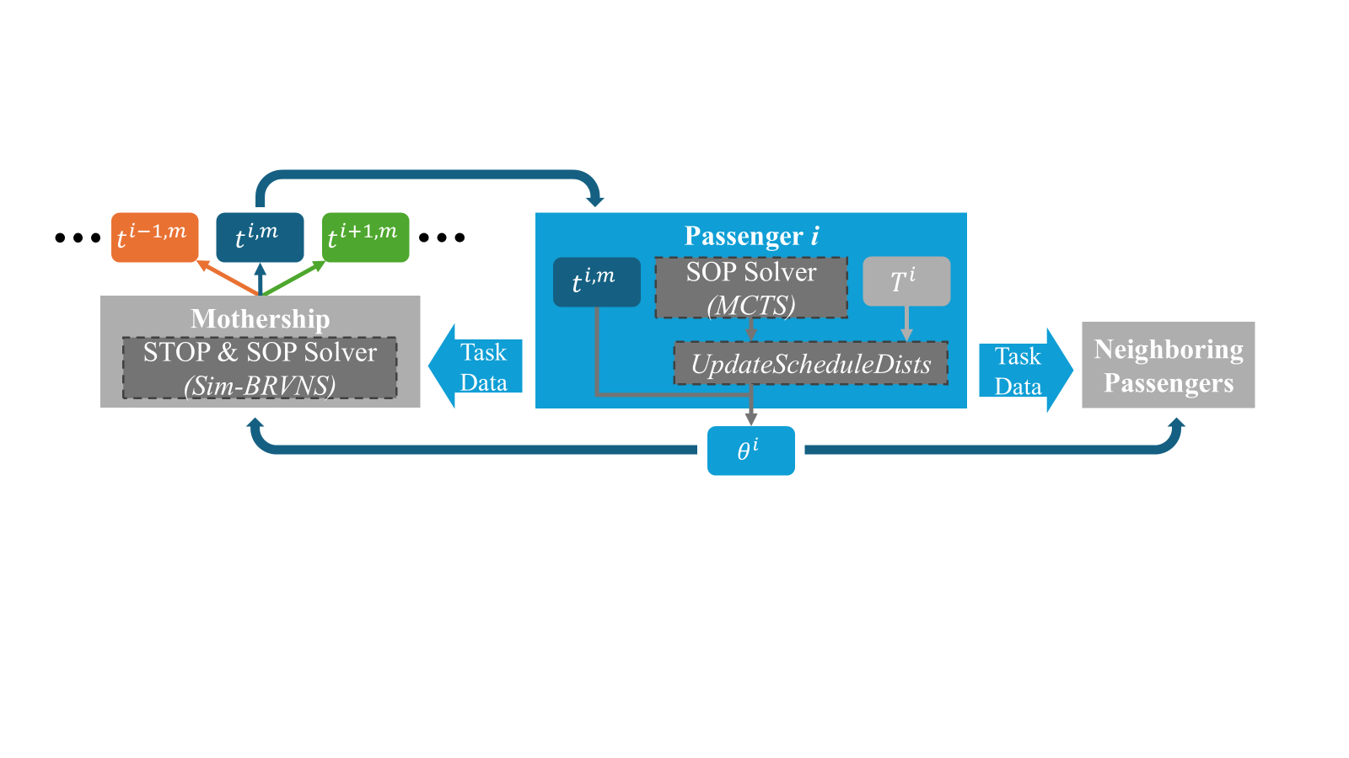

Slide 17
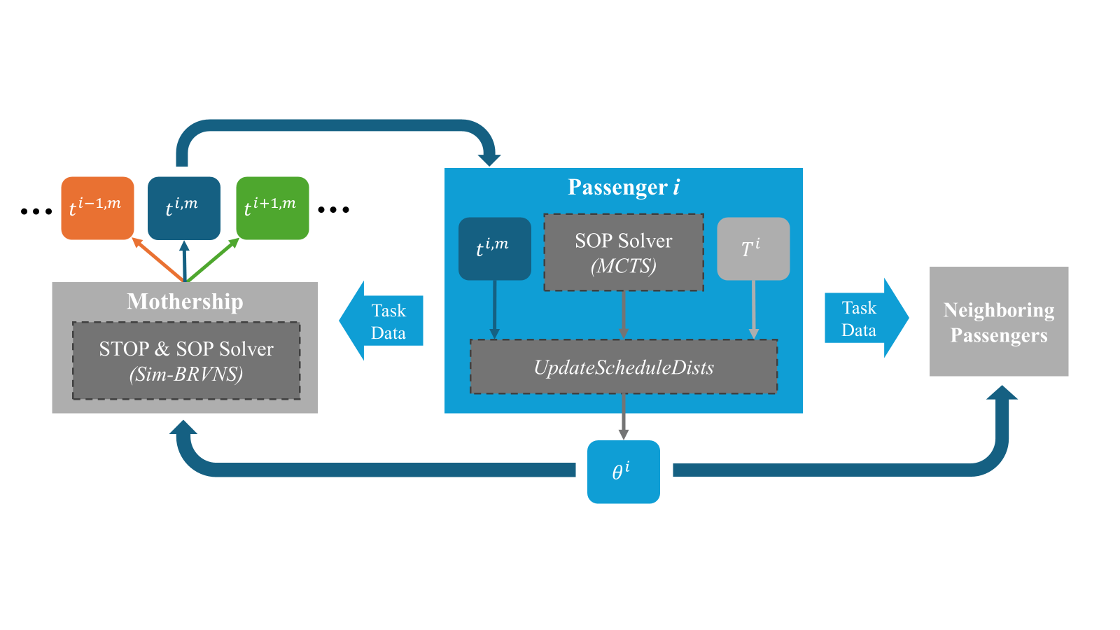

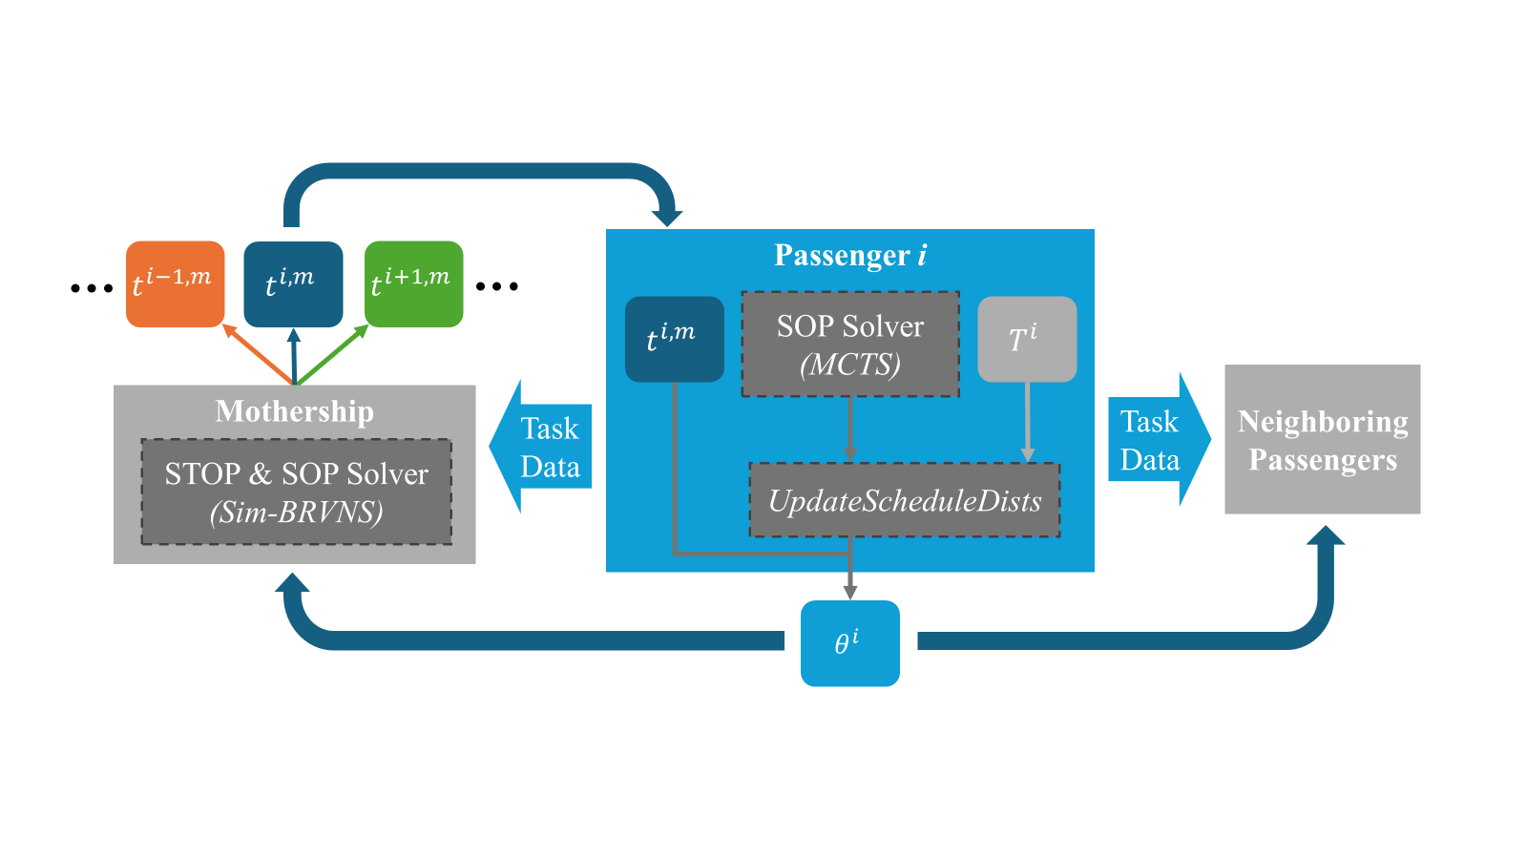
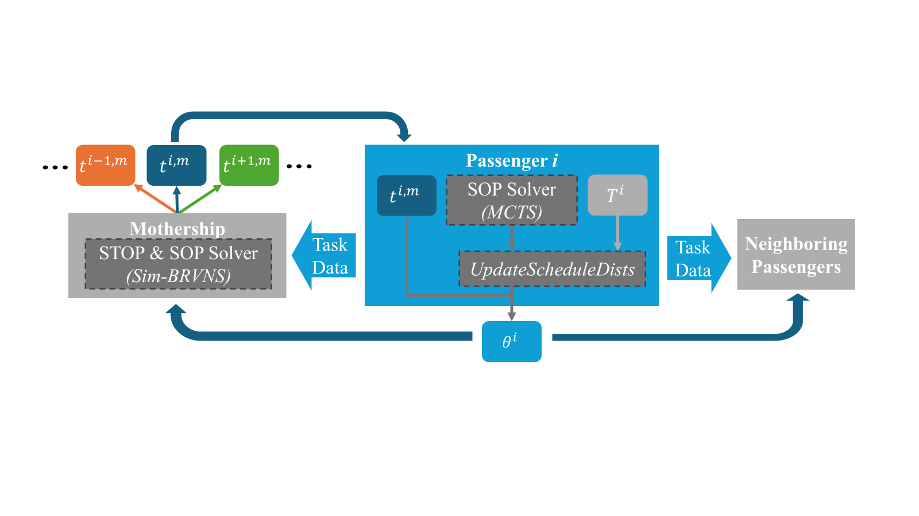

Slide 18
v
v
v
v
v
v
v
v
v
v
v
v
v
v
v
v
v
v
v
M
v
v
v
v
v
v
v
v
v
v
v

Slide 19
T
T
T
T
T
T
T
T
T
T
T
T
T
T
T
T
T
(meters)
T
M
T
T
T
T
T
T
T
T
T
T
T
(meters)

Slide 20
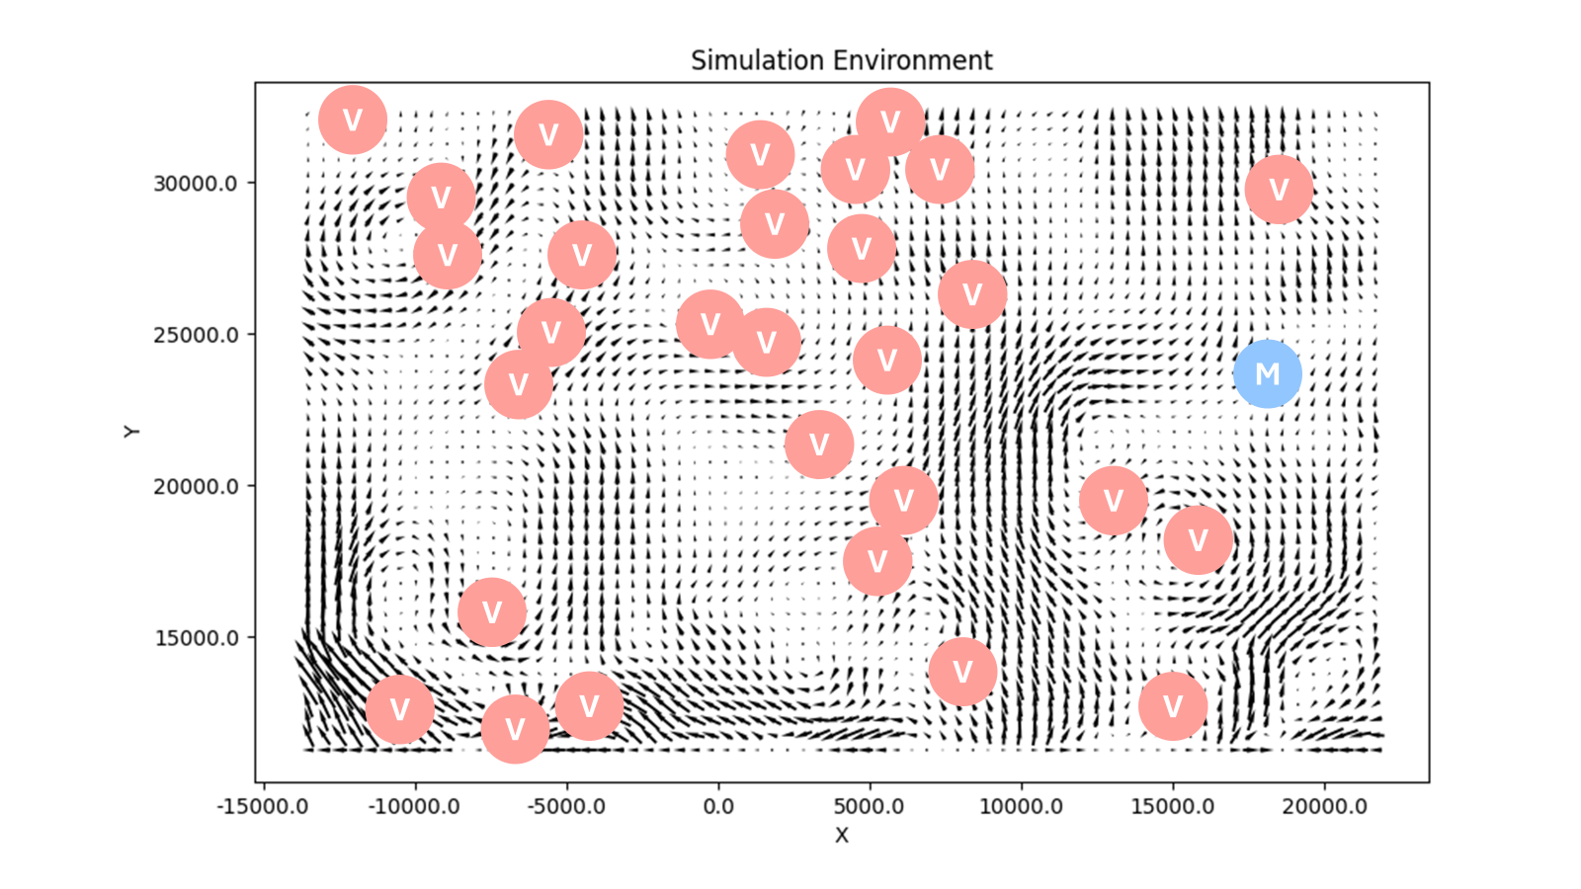
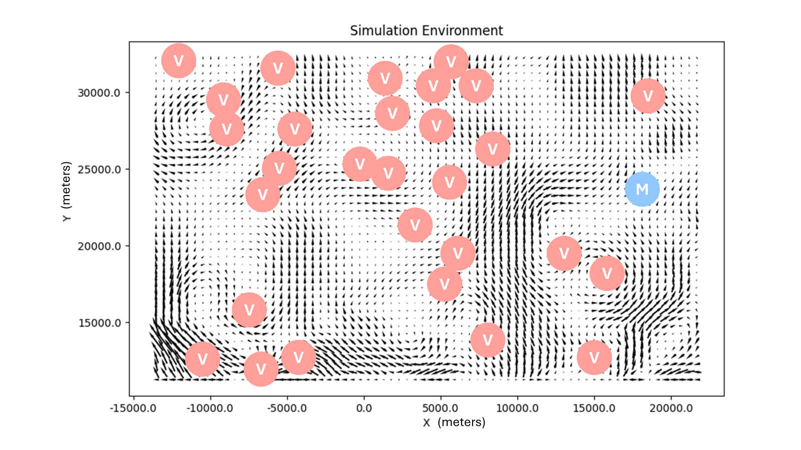

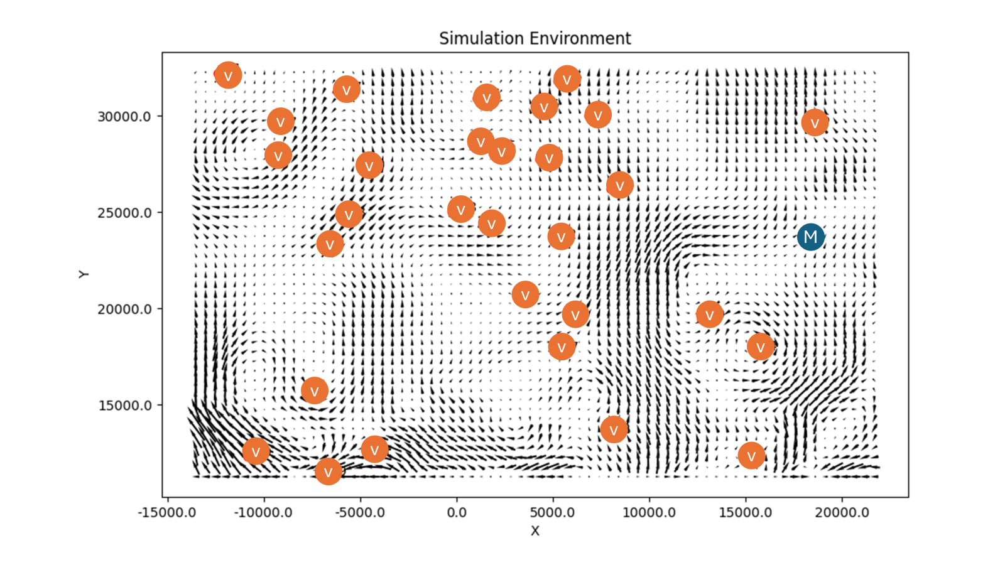
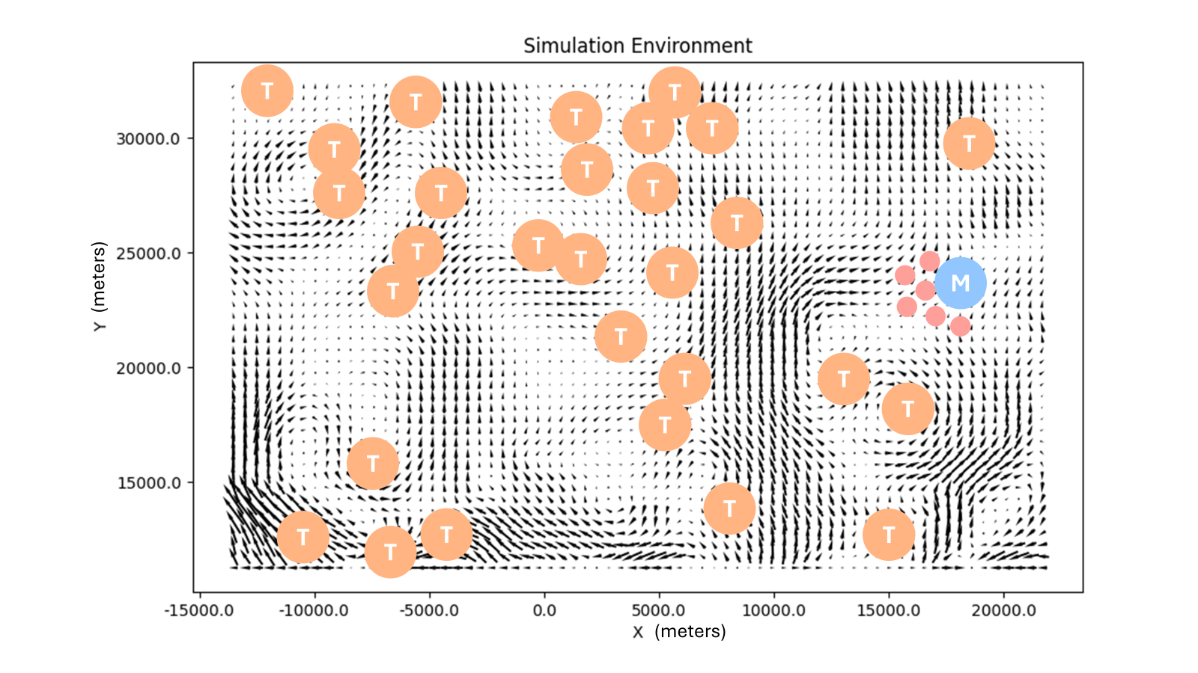
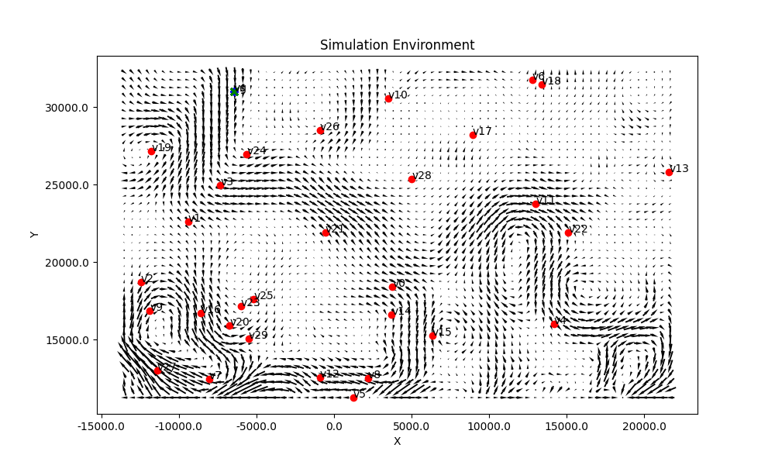

Slide 21
Algo. Variations
FE
D
FE+D
HybDO <- Added
FE+HybD
Should tell us about benefits from FE plan vs benefits from Hyb Dist solver

Slide 22
Displaying Results
% Total Reward
Baseline
2.5% Fail
5% Fail

Slide 23
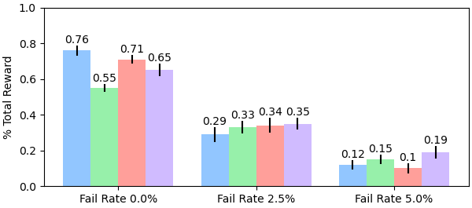
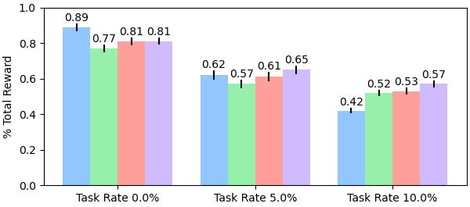
Centralized
Decentralized
2-Stage
2-Stage + Hybrid
3 Robots, 30 Tasks
6 Robots, 20 Tasks
(a)
(b)
Notes:
Hybrid topology slide(s)

Slide 24
Mothership
Passenger i
Centralized Solver
Stored Plans
Decentralized Solver
Neighboring Robots
Plan Valuation & Selection
$$P_{i−2}^{}$$
$$P_{i−1}^{}$$
$$P_{i}^{}$$
Candidate Plans
Notes:
Hybrid topology slide(s)

Slide 25
